Slide 1
Creating mathematical problems related to trees
Comenius projekt: More trees, yes please!

Slide 2
Math + problem + imagine =
…wait and see

Slide 3
Oh, those fractions!

Slide 4
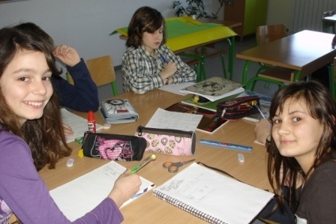
One day, we’ve had an experimental way of teaching fractions:
What is the phrase?
1st word: the third fifth of the word CEDAR+the second fifth of the word HRAST+V+the fourth fifth of the word JAVOR
2nd word: the fifth sixth of the word PINIJA+the fourth sixth of the word SMREKA
3rd word: the third fourth of the word LIPA+the third eighth of the word MARELICA+the first fourth of word the VRBA+the second third of the word BOR
Solution: DRVO JE PRVO ( the wood is the first)
cedar = cedar; hrast = oak; javor = maple; smreka = spruce; lipa = linden;
marelica = apricot; vrba = willow; bor = pine

Slide 5
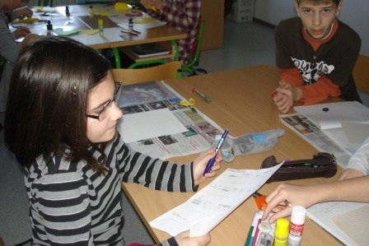
Students say that it’s easier to learn fractions if you make those kind of tasks
1st word: the third fifth of the word JAVOR+the second fourth of the word LIPA+the fourth fifth of the word HRAST+the second third of the word BOR+the first sixth of the word KRUŠKA+ the second sixth of the word TOPOLA
2nd word: the first third of the word DUD+the second fifth of the word BREZA+the first fourth of the word VRBA+the second fourth of the word JOHA
3rd word: the first sixth of the word PAPAJA+the first fifth of the word LIMUN+the second ninth of the word BOROVNICA+ the fifth sixth of the word JAGODA+the sixth sixth of the word TREŠNJA
4th word: the first seventh of the word NARANČA+the second third of the word CER+the first ninth of the word MANDARINA+the sixth sixth of the word SMOKVA
Solution: VISOKO DRVO, PLODA NEMA!(tall tree, no fruit!)
javor = maple; lipa = linden; hrast = oak; bor = pine; kruška = pear; topola = poplar
dud= mulberry ; breza = birch; vrba = willow; joha = alder; papaja = papaya; limun = lemon; borovnica = blueberry; jagoda = strawberry; trešnja = cherry; naranča = orange; cer = Turkey oak; mandarina = tangerine; smokva = fig

Slide 6
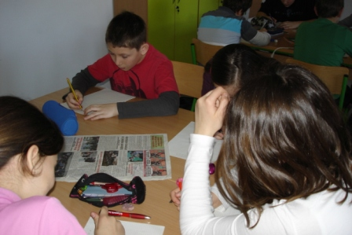
Letter by letter…
________ NE PADA DALEKO OD_______
1st word: the first two fifths of the word JASEN+the first three fifths of the word BUKVA+the third fourth of the word ORAH
2nd word: the last two fifths of the word HRAST+the last two fourths of the word GRAB+the first sixth of the word LUŽNJA+the last fourth of the word VRBA
Solution:
JABUKA NE PADA DALEKO OD STABLA
(An apple doesn’t fall far away from the tree)
The 2nd and 3rd fifths of the word HRAST ____
The 4th fifth of the word BREZA ____
The 1st fourth of the word LIPA ____
The 2nd third of the word BOR ____
The 2nd sixth of word SMREKA ____
The 1st seventh of word CVIJEĆE ____
The 2nd fourth of word LIPA ____
Solution: RAZLOMCI (fractions)

Slide 7
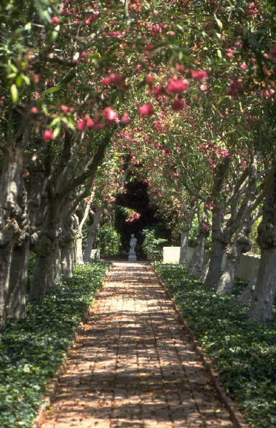
Task-it’s like you have to… math story…it’s like fun
People who live in Lipa (linden tree in Croatian) street decided to plant an alley along the street to get more oxygen during the hot summers.
If the distance between two trees is 2 m, and the street is 378 m long, how many trees do they need?
Solution: (378:2+1)∙2= 380 stabala
There are 3 branches on the tree and on each brench there are 3 nests, in each nest there are 2 little birds. How many little birds are there ?
Solution: 3∙3∙2=
18 stabala

Slide 8
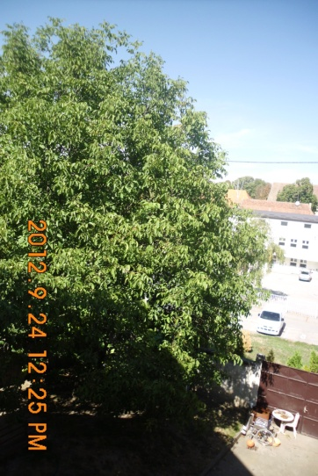
The walnut problem
Filip and his family cut a walnut tree last year, at the age of 20. As the walnut tree releases sulfur, they can plant another tree on that place not until at least one tenth of the century(1/10century – 2/5 decade) years.
How many years should they wait to succefully plant another tree?
Solution: 1/10 century is 10 years, 2/5 decade is 4
years; 10 – 4 = 6 years

Slide 9
Axial symmetry
??? Rather confusing for the fifth grade

Slide 10
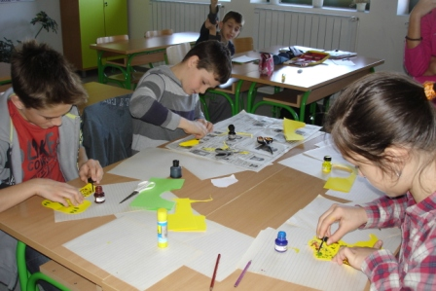
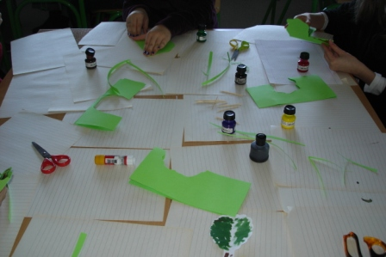
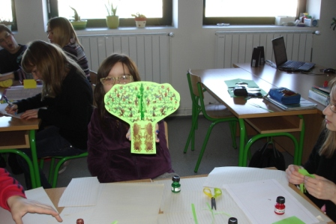
Paper, colour inks, scissors…they done miracles
working…
the first results…

Slide 11
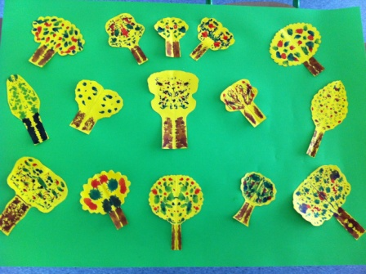
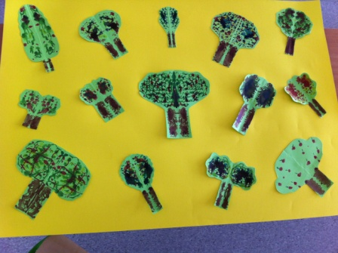
And, in the end…

Slide 12
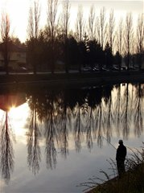
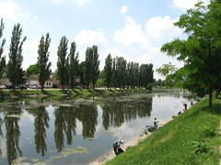
With the camera in the city on the river, you can’t miss axial symmetrics
by the river Bosut, where people lives continuously for 9000 years

Slide 13
Enigmatika and math are related?
Heureka!

Slide 14
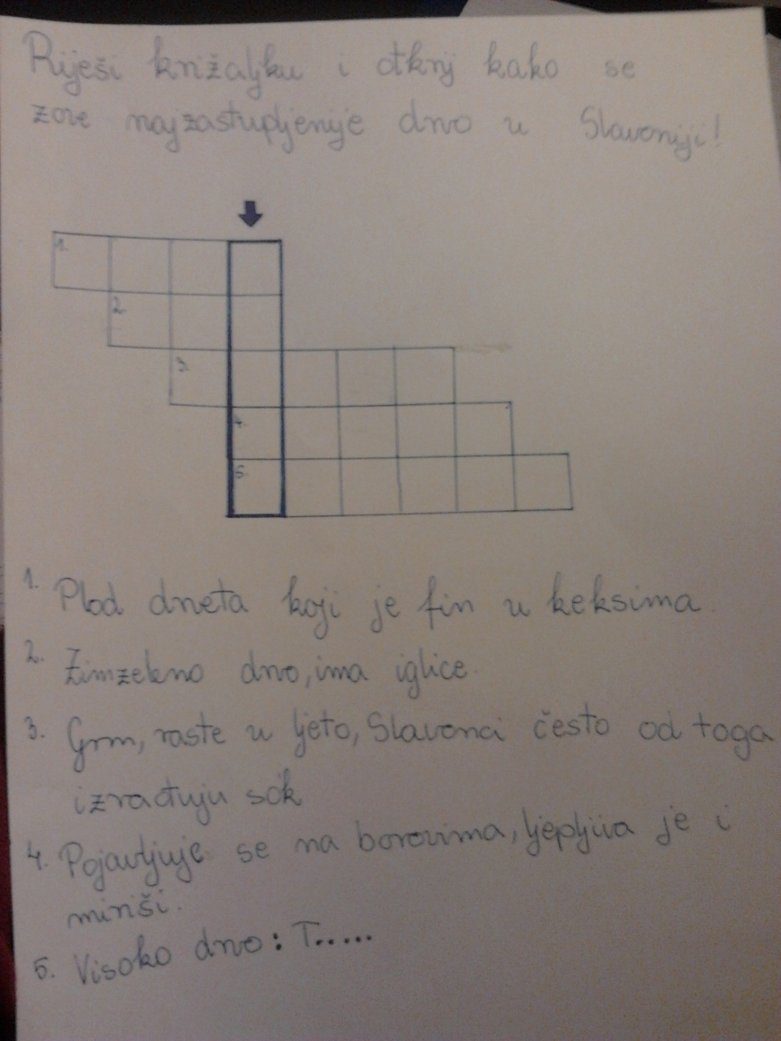
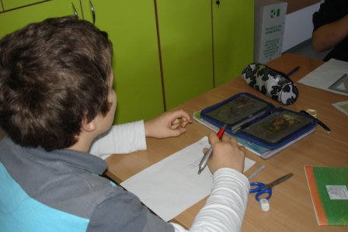
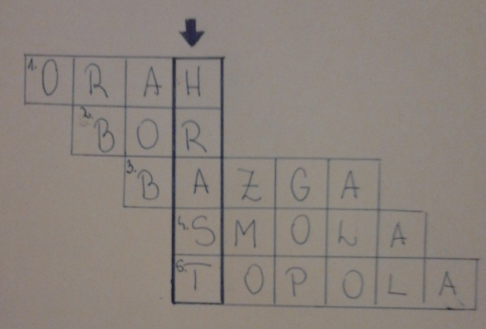
The crosswords
working…

Slide 15
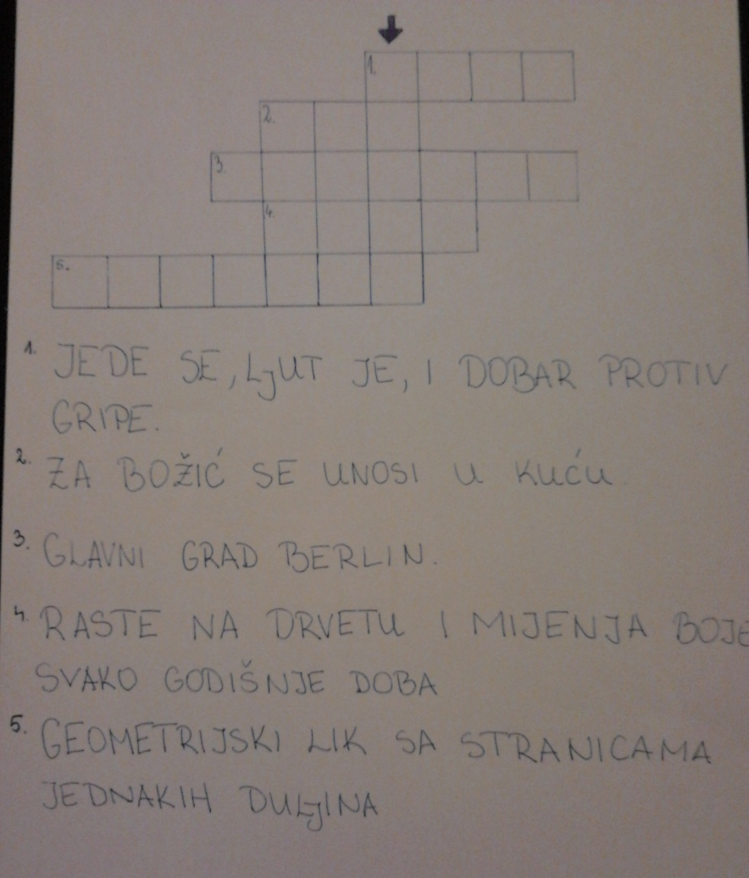
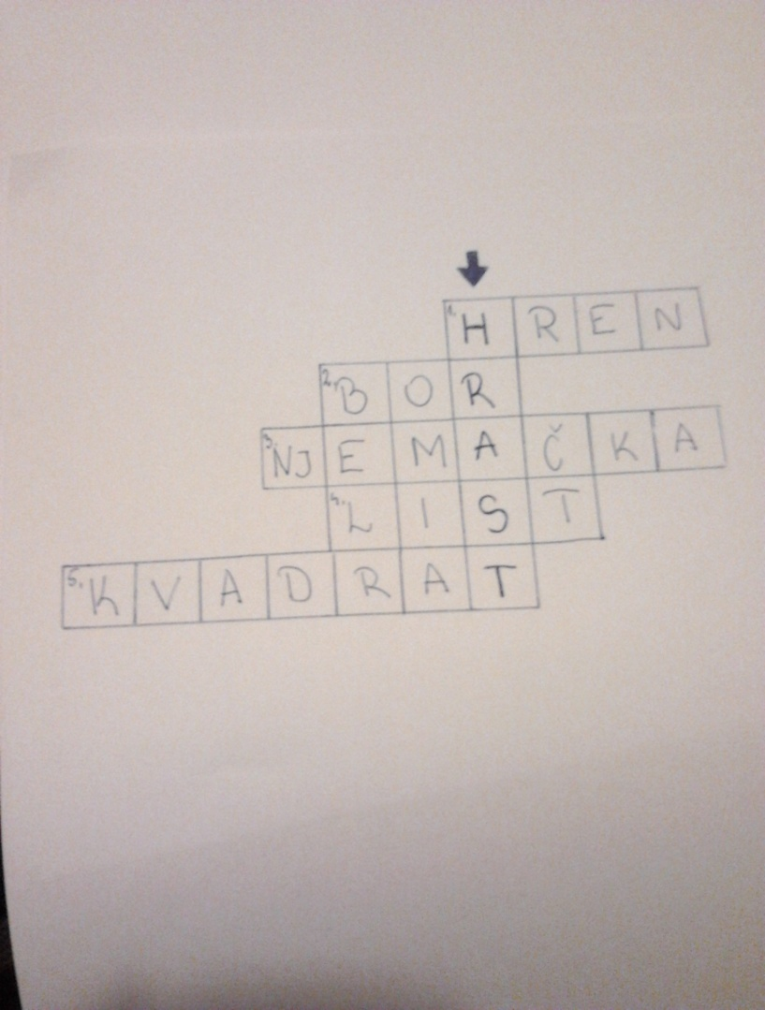
The crosswords were the most popular to do…

Slide 16
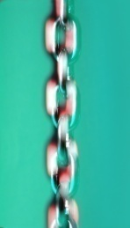

The rebuses
‘’’
+ ‘
+
‘’’
‘’’
Solution: JELA (Croatian tree)
Solution: JABLAN (Croatian tree)

Slide 17
The association game

Slide 18
A1
B1
C1
A2
B2
C2
A3
B3
C3
The solution of A column
The solution of B column
The solution of C column
The final solution

Slide 19
It has fruits
It is green
There are gifts under it
It has no leaves in the winter
It has little needles
Christmas
It has leaves
It has leaves in the winter
There are decorations all over it
DECIDUOUS TREE
EVERGREEN TREE
CHRISTMAS TREE
TREE

Slide 20
Pythagoras tree

Slide 21
Yes, trees helps to understand better Pythagorean theorem…
Students of the 8. grade were drawing some odd, squared trees with the help of Pythagorean theorem…
Pythagorean theorem has served us in the construction of one beautiful fractals called Pythagoras tree. Symmetrically Pythagoras tree occurs that of one side of the square we construct an isosceles right angled triangle.
Bough by bough…
And, those are the results…

Slide 22
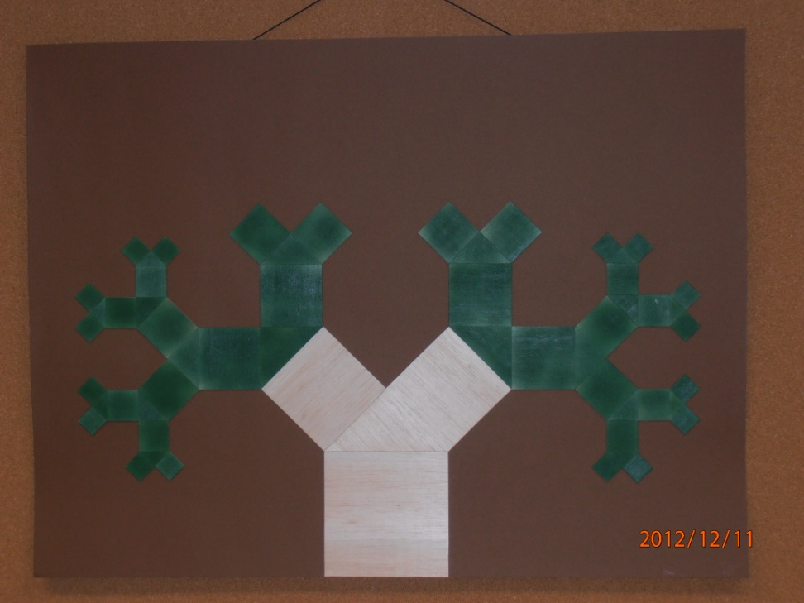
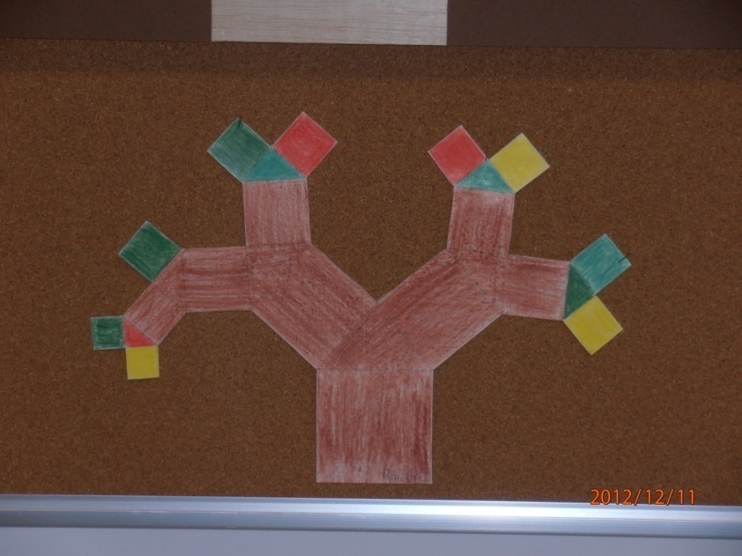

Slide 23
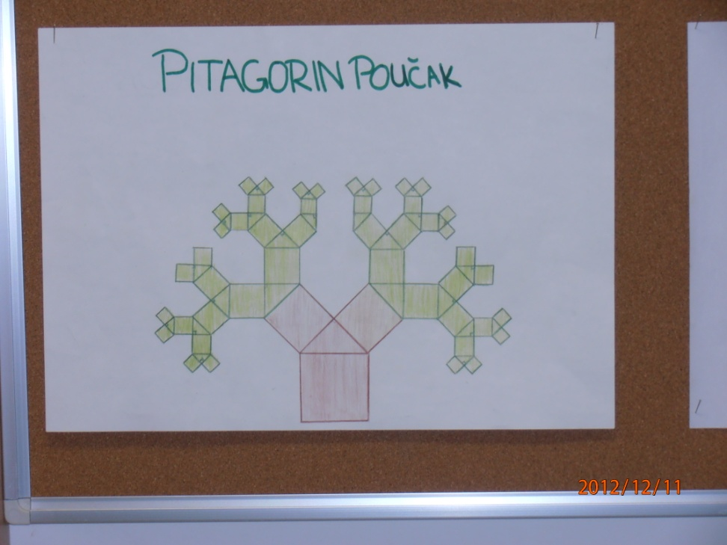
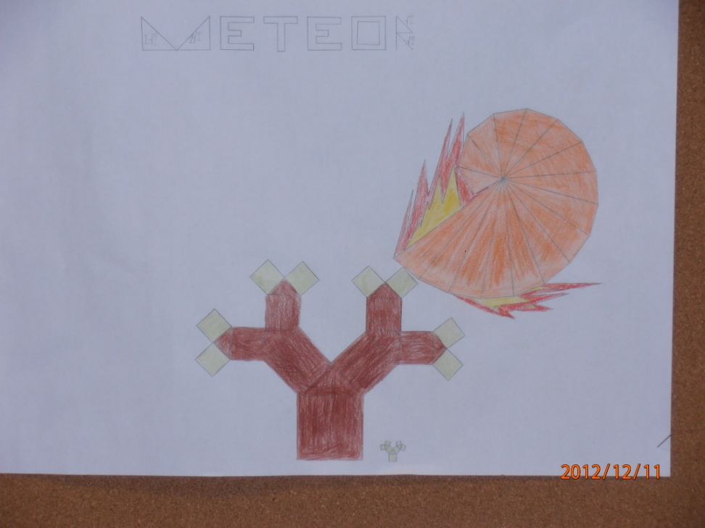

Slide 24
Pythagoras tree has made by dynamic geometry software GeoGebra

Slide 25
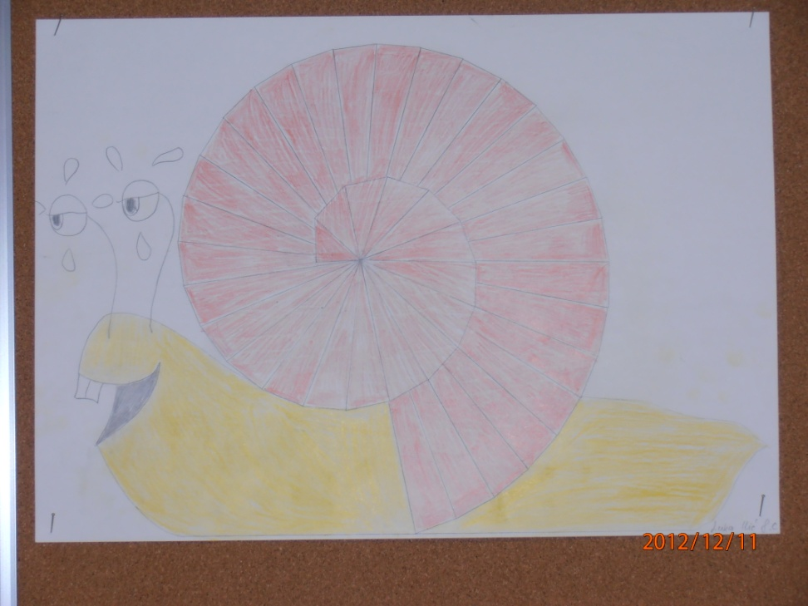
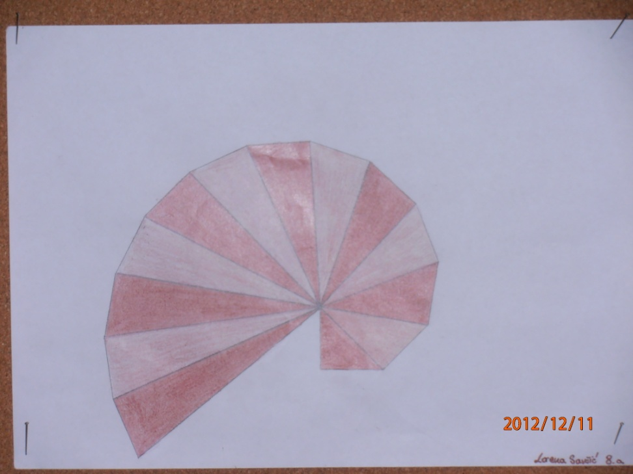
Rectangular triangles leads us to snail and sea shell…

Slide 26
Coordinate system in a slightly different way

Slide 27
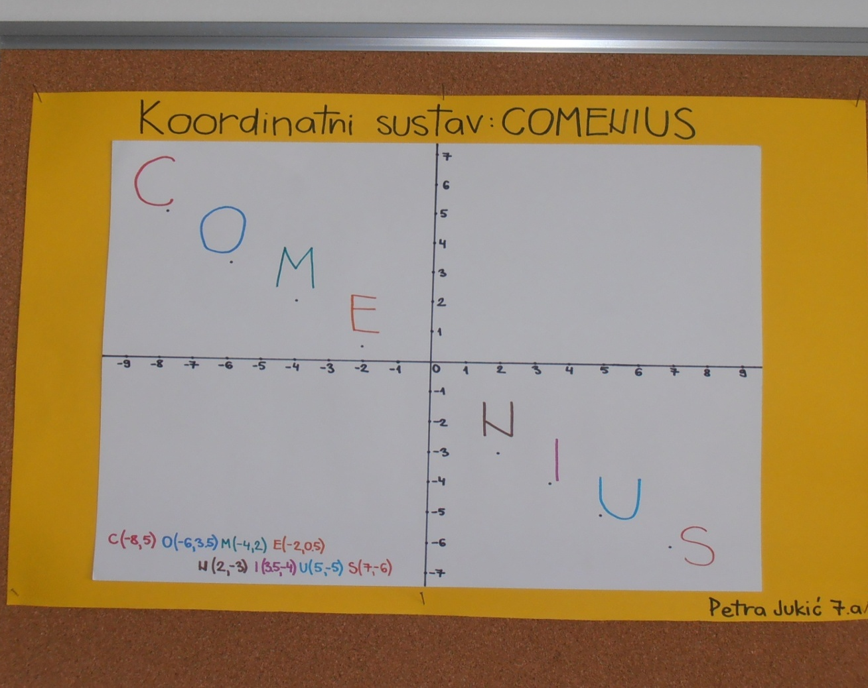

Slide 28
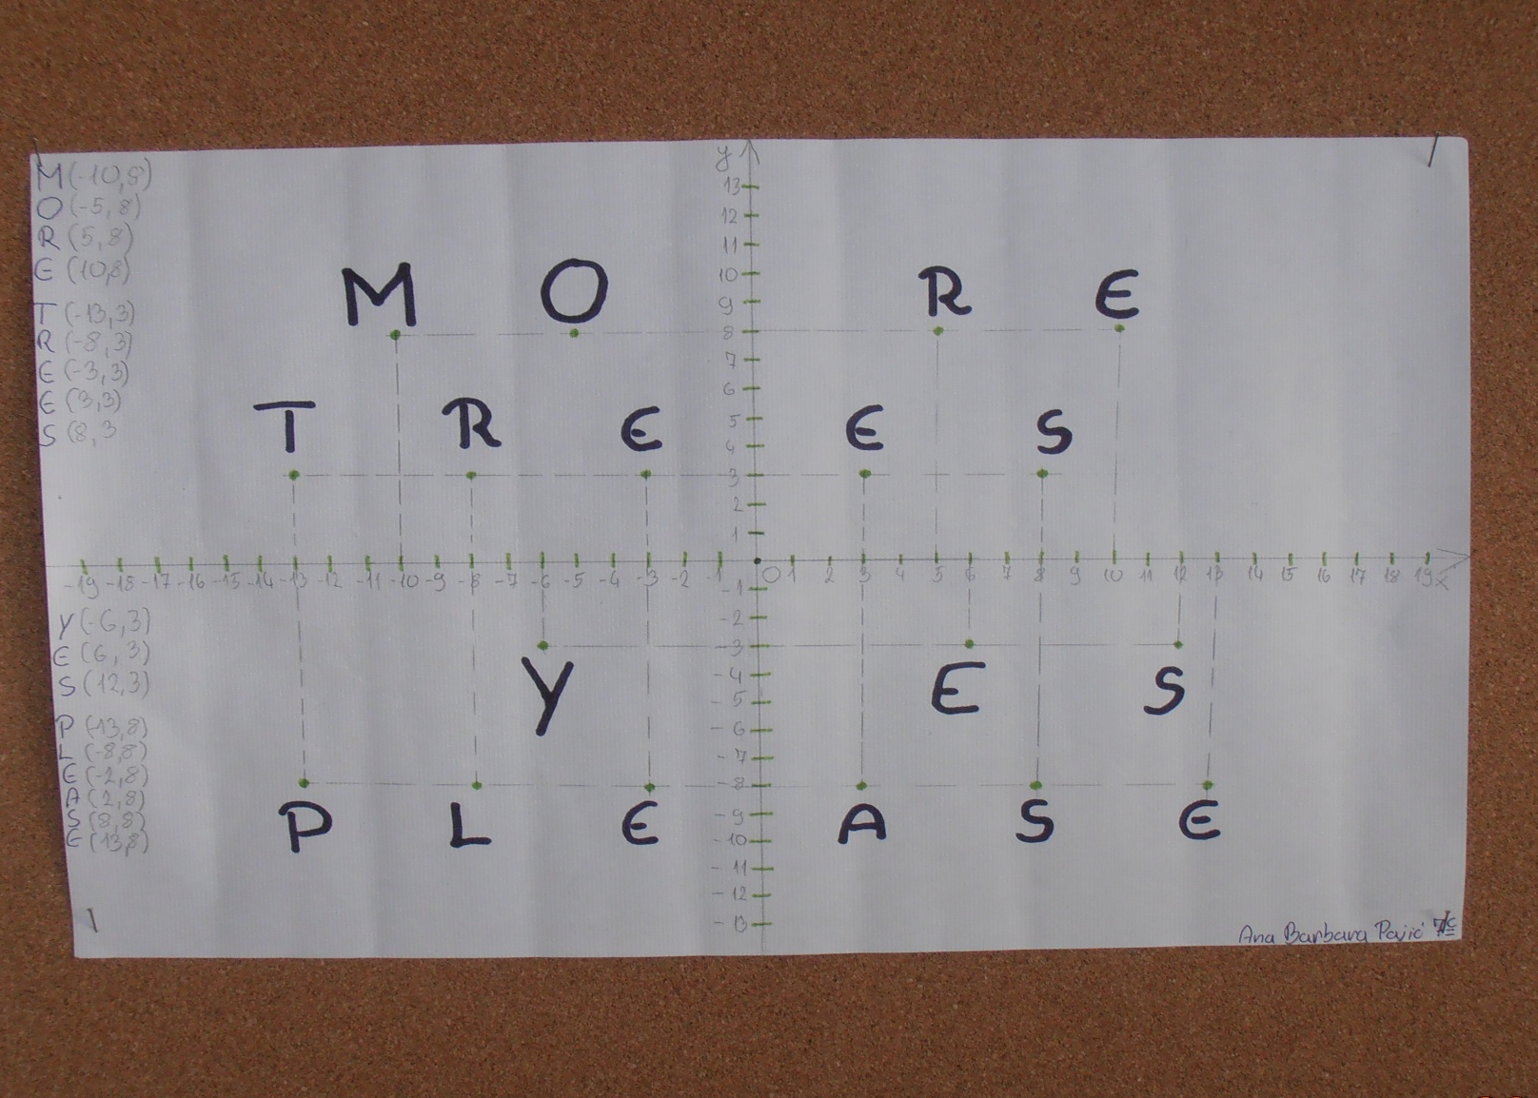

Slide 29
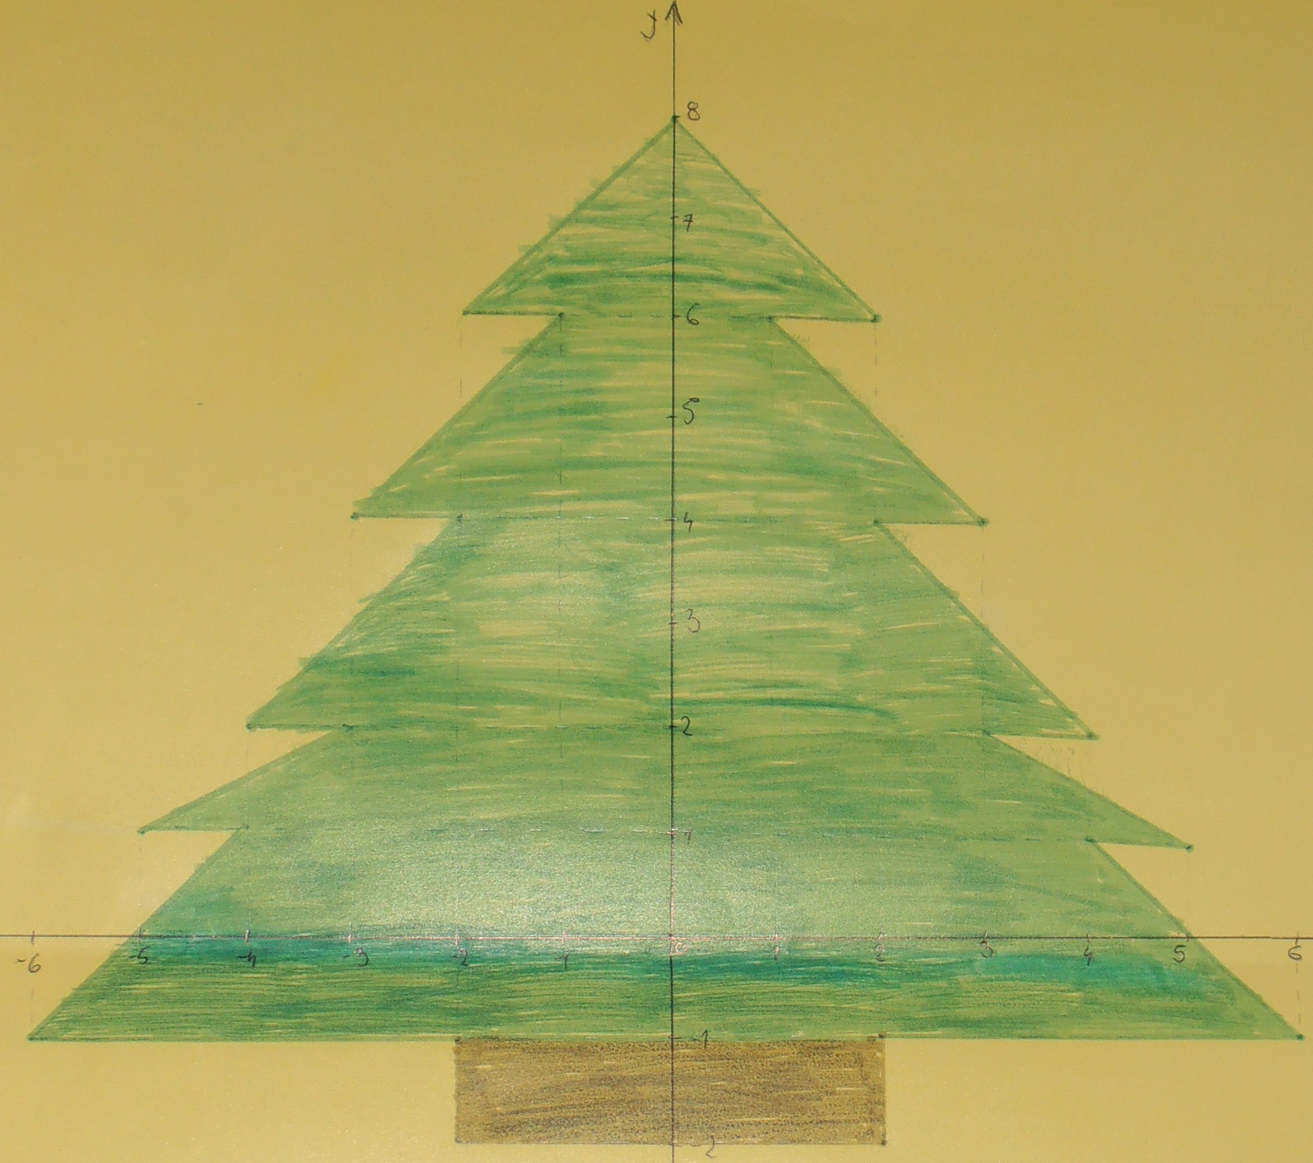

Slide 30
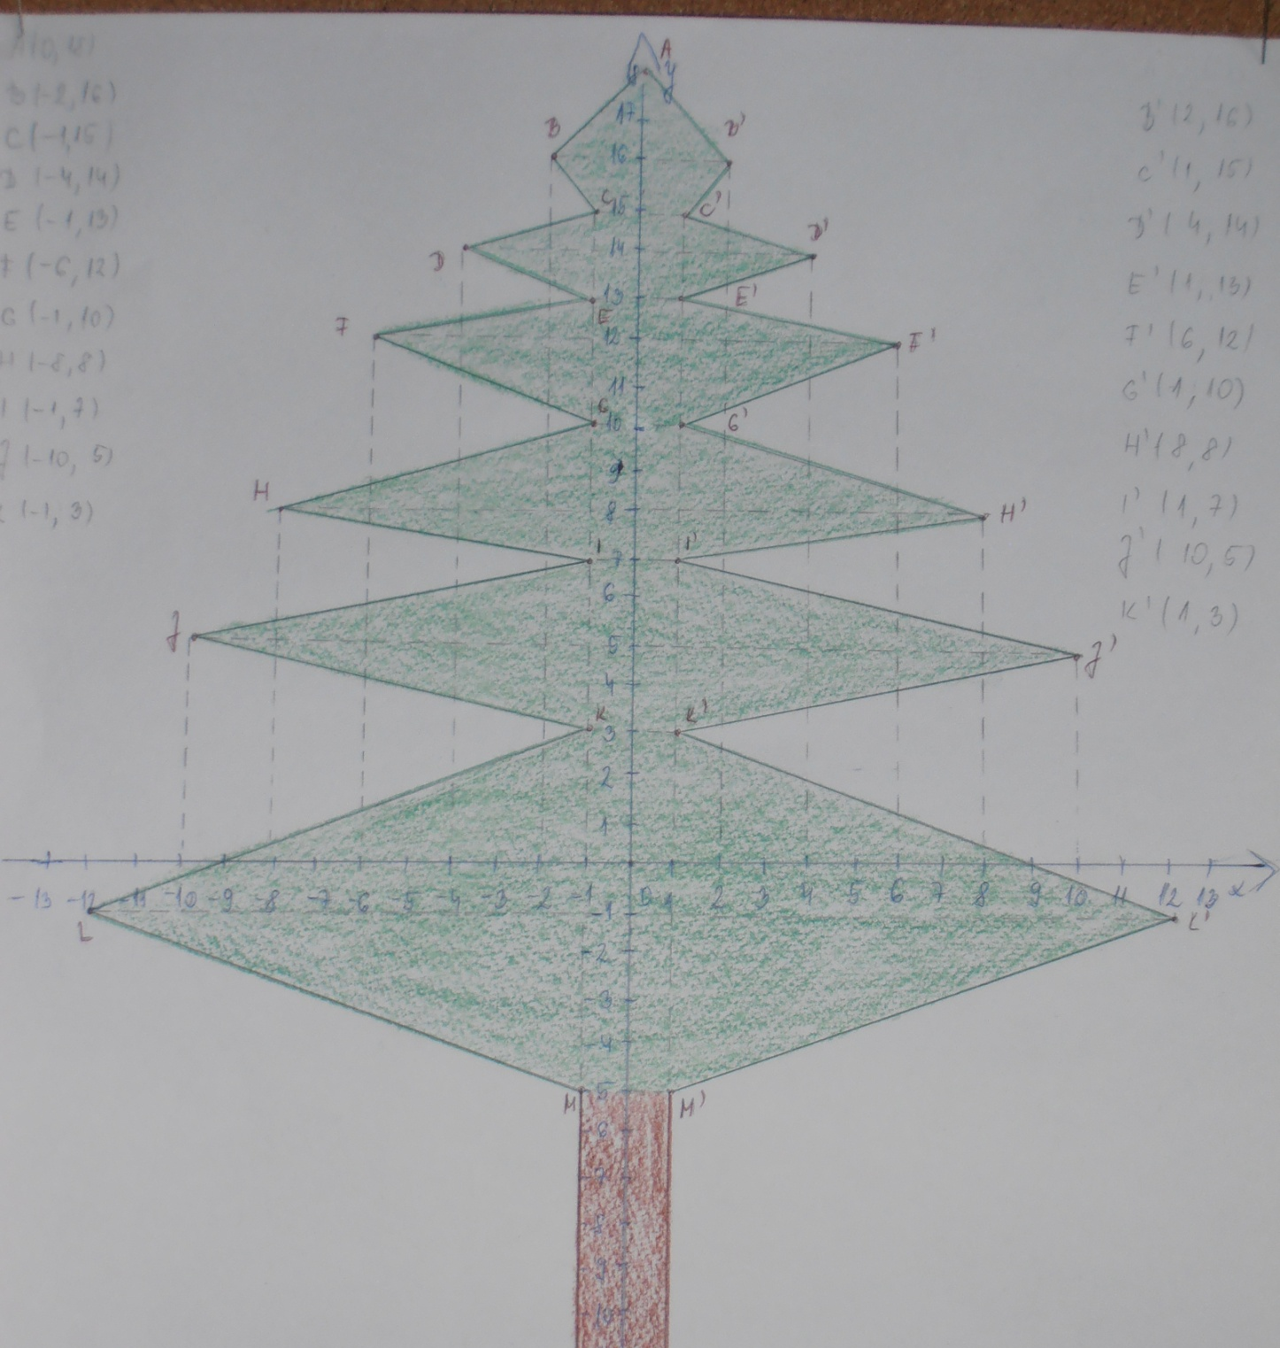

Slide 31
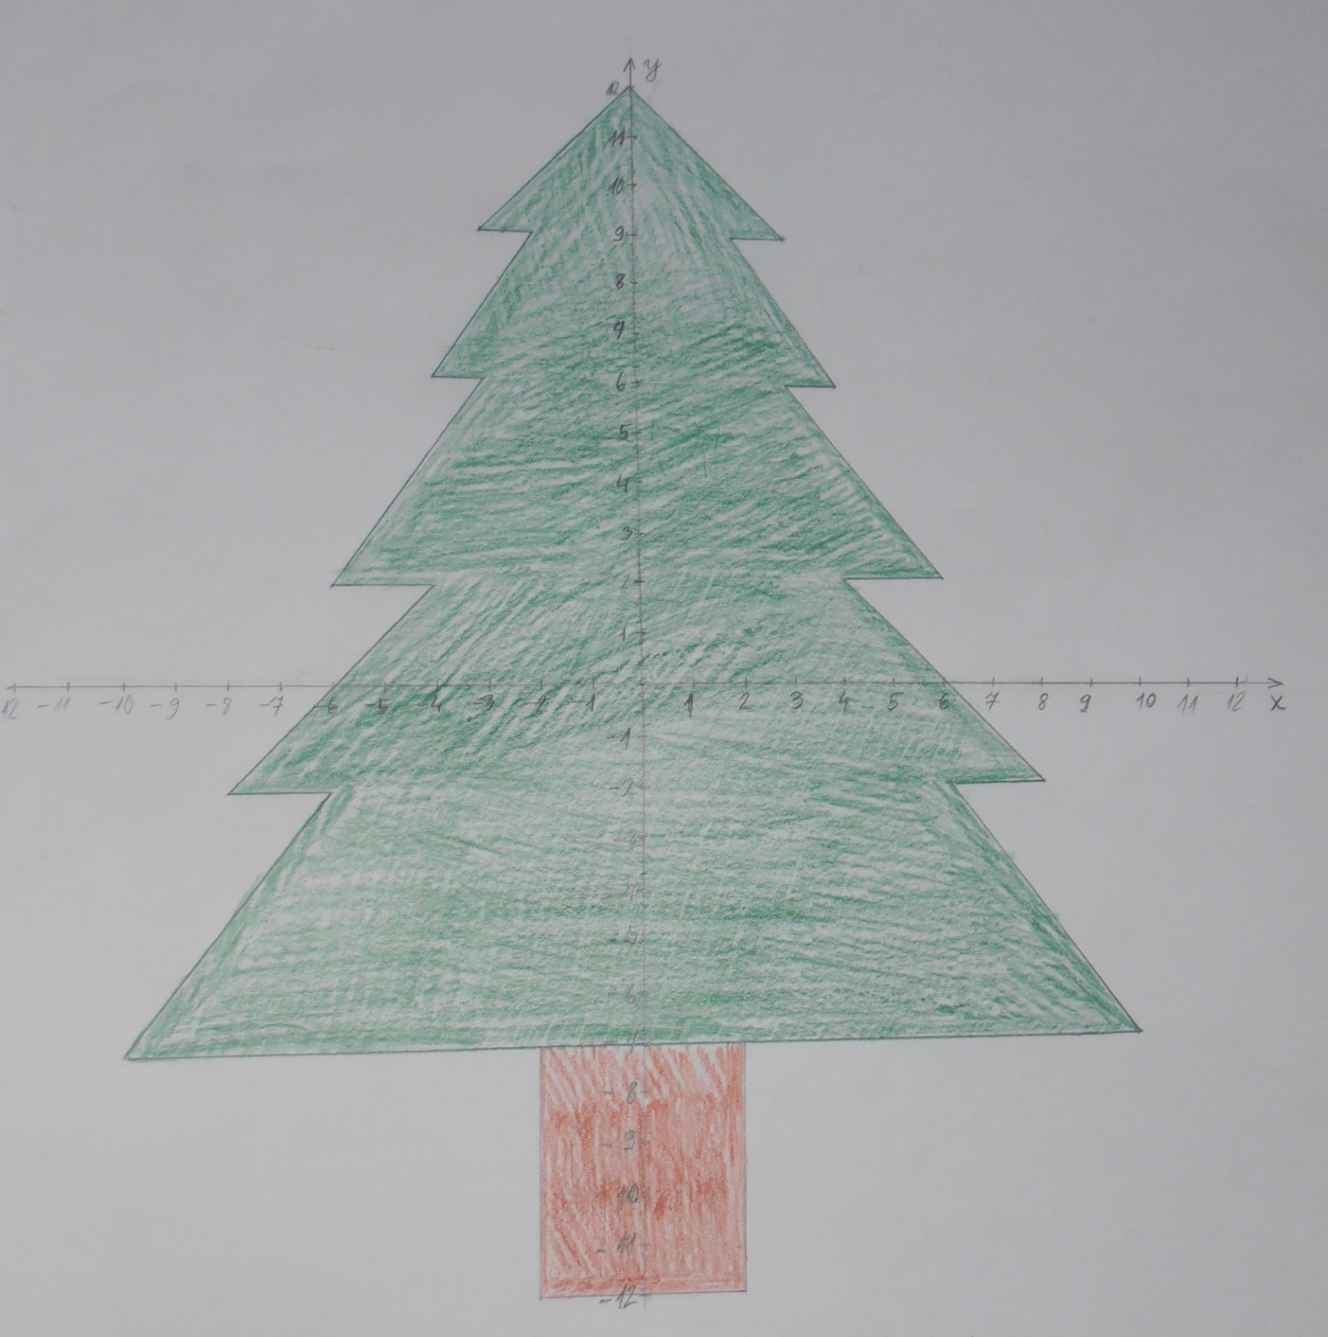

Slide 32
Statistics
My class’ favourite tree

Slide 33
Poll
What’s Your favourite tree:
English oak
hornbeam
maple tree
elm
willow

Slide 34
Poll results by classes

Slide 35
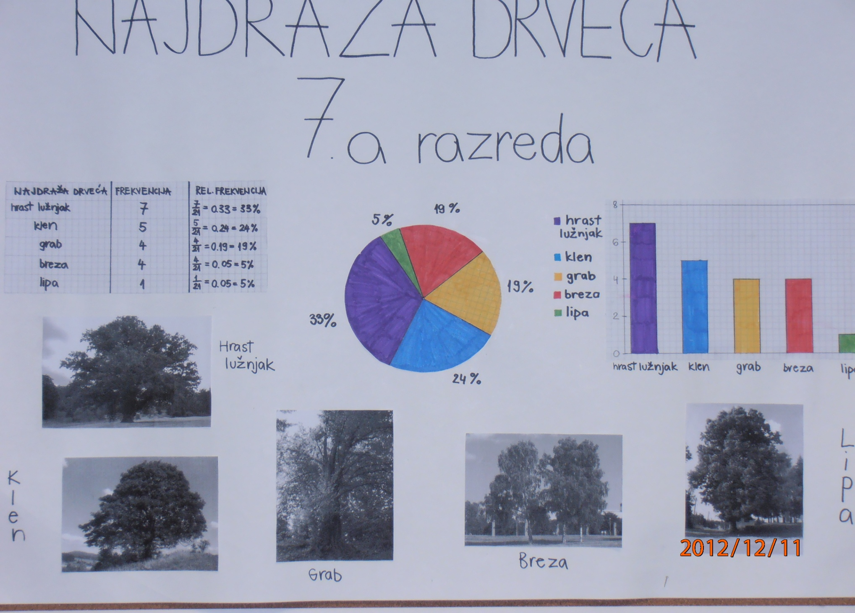

Slide 36
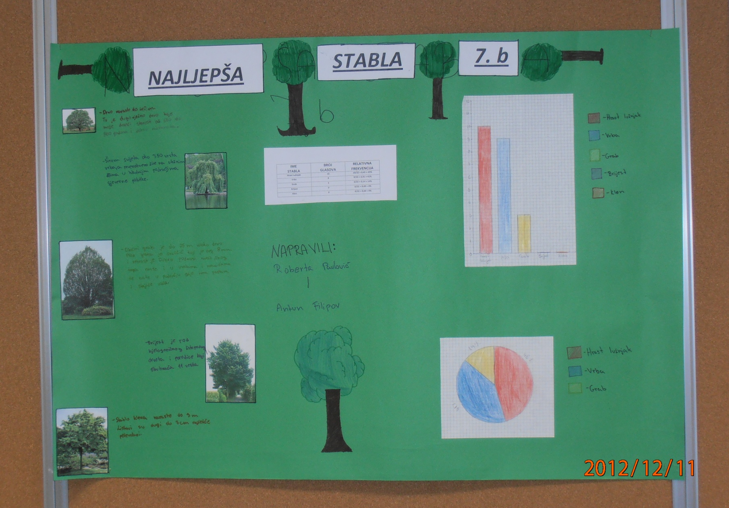

Slide 37
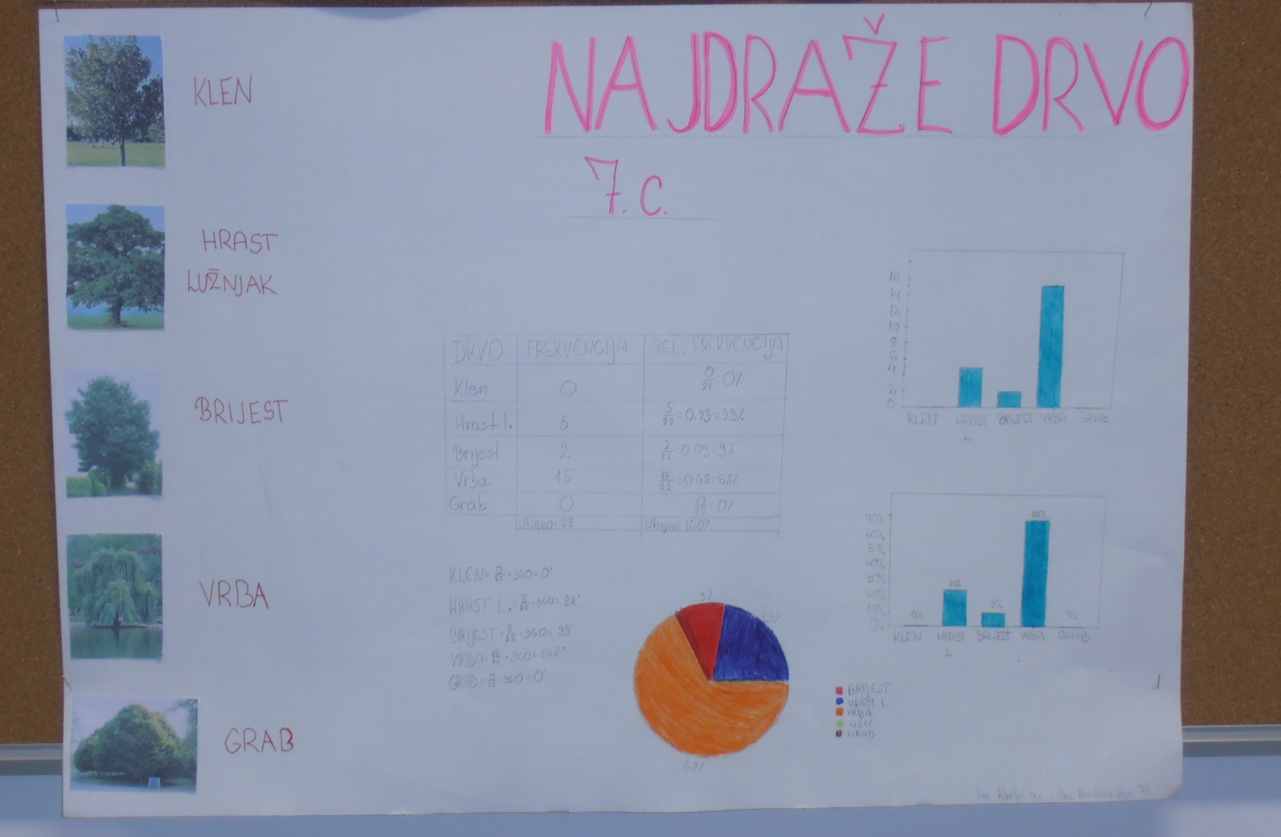

Slide 38
Favorite tree | 7.a | 7.b | 7. c
English oak | 33% | 45 % | 23 %
hornbeam | 19 % | 14 % | 0 %
maple tree | 24 % | 0 % | 0 %
elm | 19 % | 0 % | 9 %
willow | 5 % | 41 % | 68 %

Slide 40
Similarity of triangles

Slide 41
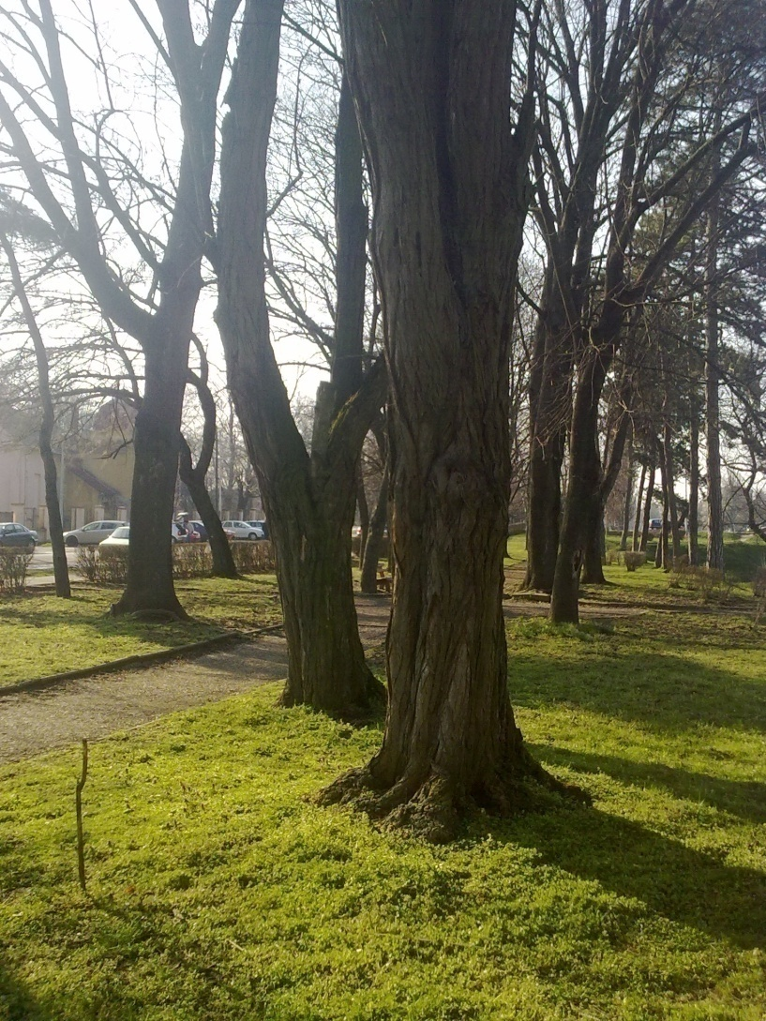
I wonder how tall that tree is?

Slide 42
Hmm, if Tales could define the height of Cheops pyramid 2500 years ago, why couldn’t I calculate the height of this tree…

Slide 43
All I need is a wooden stick, measuring tape and some mathematical knowledge about the similarity of triangles.

Slide 44
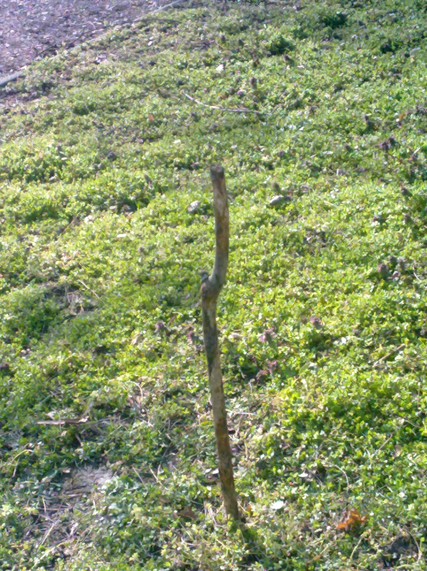

Slide 45
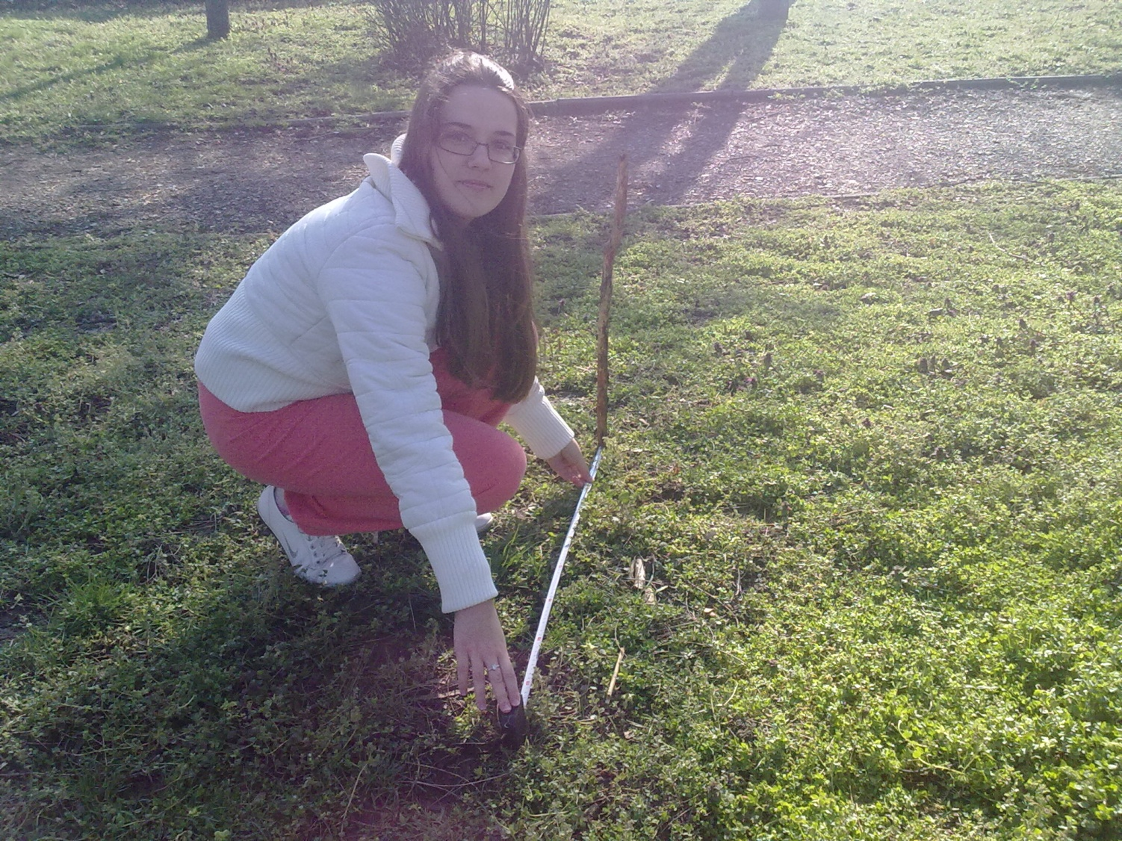

Slide 46
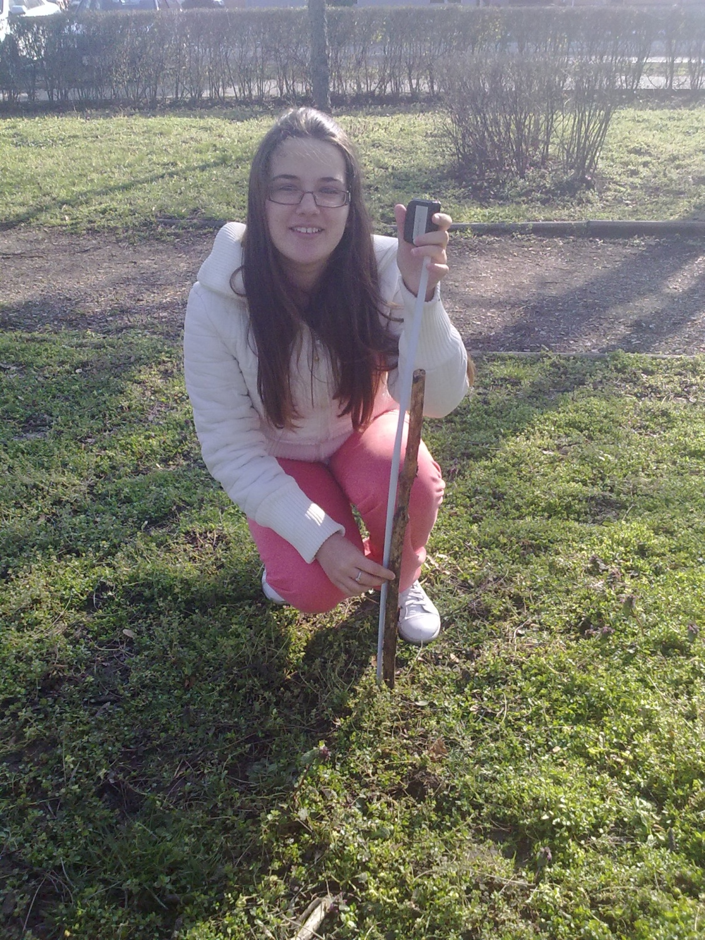

Slide 47
Measuring results:
Tree shadow length 15.7 m
Wooden stick height 0.85 cm
Wooden stick shadow length 1 m

Slide 48
Now I only have to do a little math
TREE
STICK
x
0,85 m
15.7 m 1 m

Slide 49
Tree height : stick height = tree shadow : stick shadow
x : 0.85 = 15.7 : 1
x = 13.345 m
So, the tree is 13.345 m high.

Slide 50
Arranged by math teachers :
Sandra Pernar
Mirjana Javor
Marija Čopčić Banovac and their students
March, 2013.
Primary school Ivan Mazuranic
Vinkovci
Republic of Croatia

