Slide 1
Chrictmas decoration

Slide 2
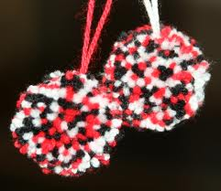
How to make tree decorations made of wool

Slide 3
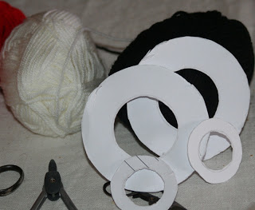
First prepare two cardboard circle and wool (you can use one or several colors)

Slide 4
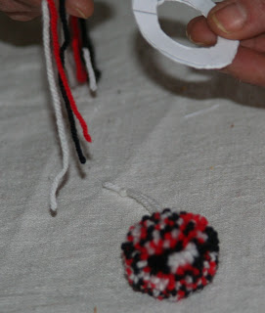
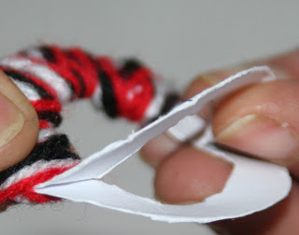
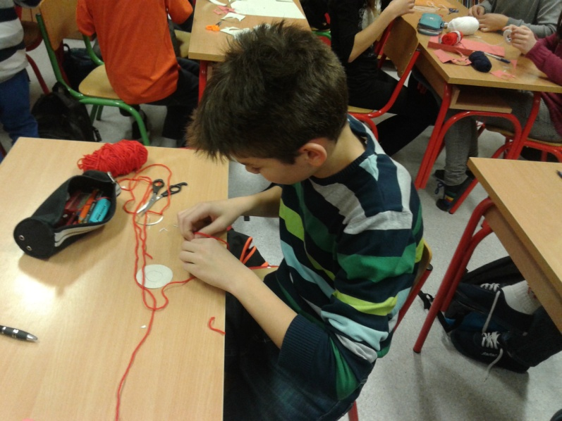
Then take two cut circles together take wool, unwind so it can easier go through a pinch circle. When you spend it just cut more wool and continue where you left off!

Slide 5
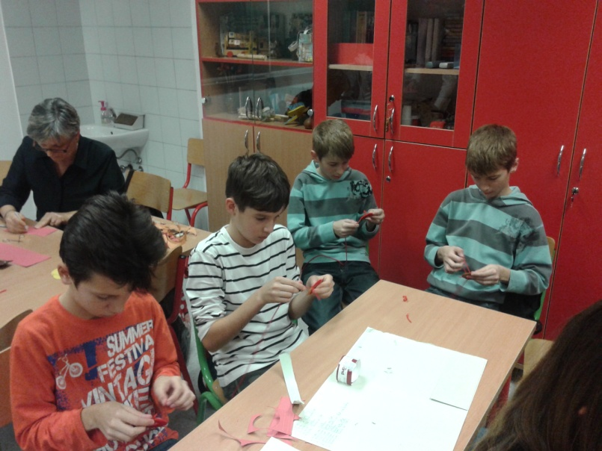
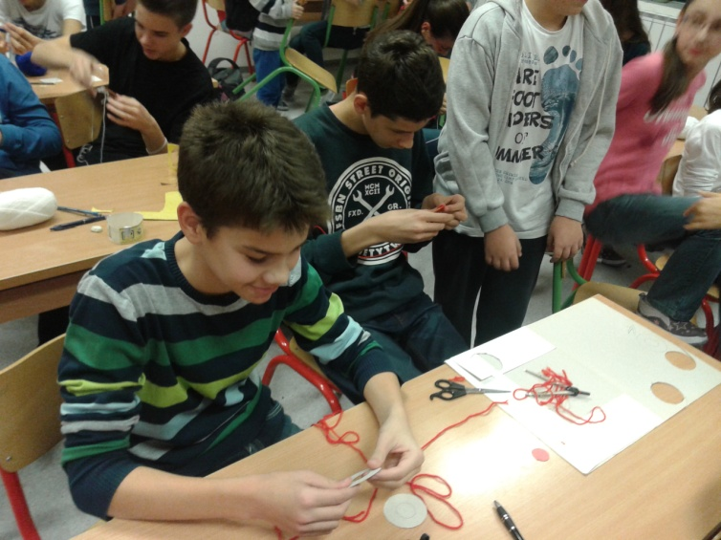
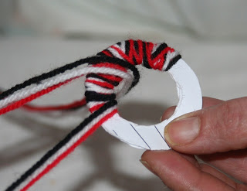
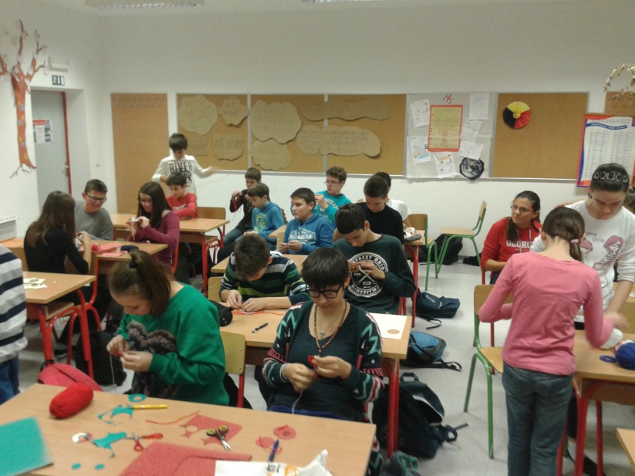
....Roll ... and roll....

Slide 6
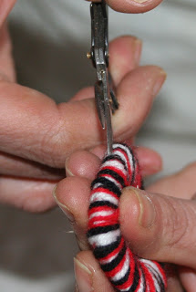
... then start cutting at the edge holding the middle ...

Slide 7
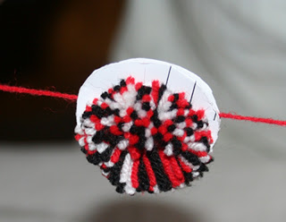
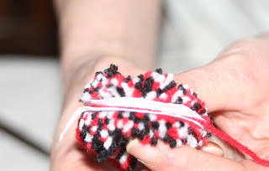
... then cut a piece of wool and place it between the board and tighten it well ...

Slide 8
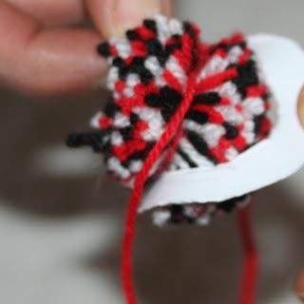
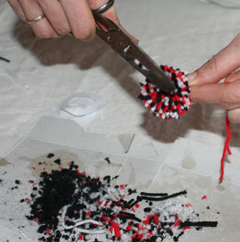
Remove the cardboard ... then trim it a bit...

Slide 9
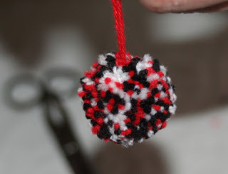
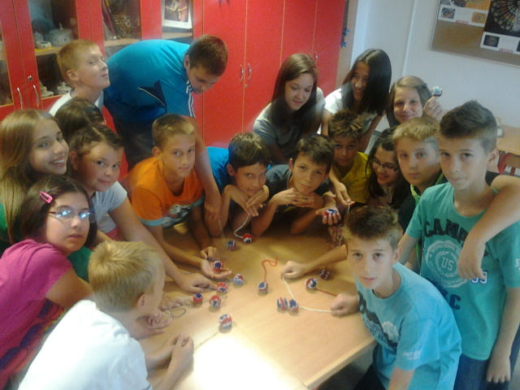
And that's it! These decorations can be perfect Christmas tree decorations

Slide 10
